Slide 1
TaxSlayer® Pro Online Practice Lab
An Introduction

Slide 2
TaxSlayer Pro Online Practice Lab Software
Use Internet Explorer 8.0 or higher, Google Chrome or Safari Browser 5.1.
For 2015 Practice Lab: https://vita.taxslayerpro.com/IRSTraining
Notes:
When you first enter the url, it will show as expanded as follows: https://vita.Taxslayerpro.com/IRSTraining/en/account/access.
TaxSlayer does not recommend using Firefox due to its weak firewalls that can be easily compromised. However, we have received reports that Firefox works as well as Edge, the browser for windows 10.

Slide 3
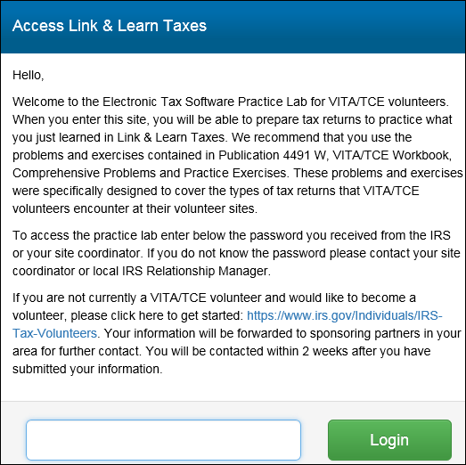
Log in - First Time
Enter Universal PW: TRAINPROWEB
Notes:
Process for logging into production is different and is explained in the video in section 1 - Pro Online Login and PW. All videos cover TaxSlayer production not Practice Lab – there are a few differences.

Slide 4
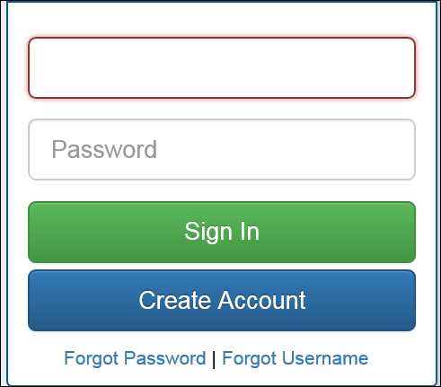
Log in – First Time (Continued)

Slide 5
Log in – First Time (Continued)
Enter e-mail address twice
Create a user name – include train or practice
Create a PW – alphanumeric with at least 6 characters (use only letters and numbers)
Enter PW twice

Slide 6
Log in – First Time (Continued)
Select “AARP Tax-Aide” from “Program Type” drop down window
Enter SIDN (if known – not required)
Select security question
Enter answer to security question

Slide 7
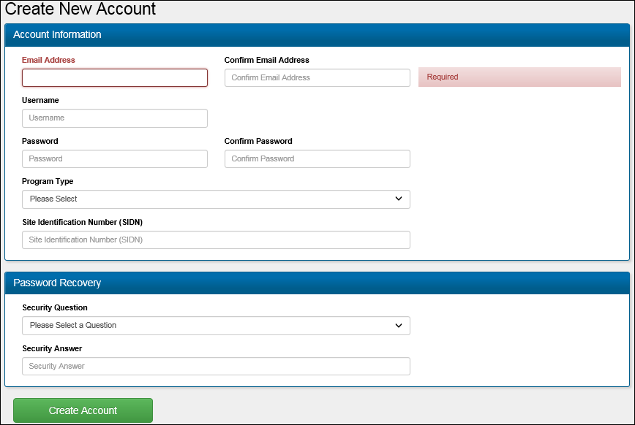
Log in - First Time (Continued)
Notes:
E-mail Address: Practice Lab displays a warning if you have previously used an email address in the Practice Lab system.
User Name: Use either Train or Practice in the user name. All user names in TaxSlayer Pro Online must be unique in all online platforms so User Name for Practice Lab cannot be used for Production. Practice Lab displays a warning if the user name has been created by another volunteer.
Password: Must be alphanumeric containing at least 6 characters. Is case-sensitive.
Program Type: Select AARP Tax-Aide from the drop-down list.
Site Identification Number (SIDN): Type in SIDN if you know it – not required
Security Question: Select a security question n from the list.
Security Answer: Type the answer to your security question.
Click Create Account

Slide 8
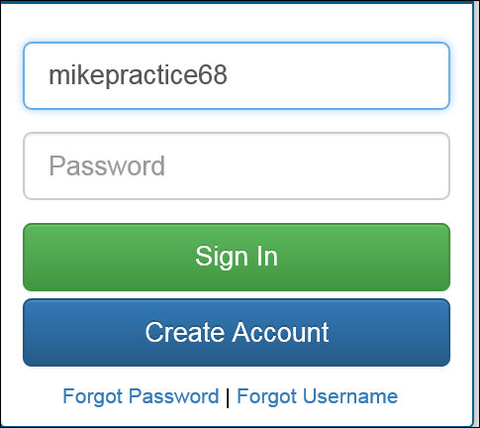
Log in – First Time (Continued)
First time you log in your user name will be shown
Enter PW you just created and click on Sign in
Notes:
Refer to using the Practice Lab manual available on OSHC (Tax Training then TaxSlayer then select Practice Lab Intro & using the Practice Lab)
Next: how to set up a number of users for classes and labs.

Slide 9
Creating Accounts for Classes/ labs
Instructor creates account for each student using:
  Student’s email address
  User name in standard format of 1st initial + last name + PL + group Identifier (e.g., site name)
  PW that is same for all students
  Security question/answer that is same for all students
Notes:
Assumes that students have not previously created an account in Practice Lab

Slide 10
Creating Accounts for classes/Labs – Students with account
Three Options:
  Student supplies username and PW to instructor or,
  Same as above but student changes PW to instructor supplied PW by using Forgot PW link or,
  New account created for student using dummy email.
Notes:
Refer to Practice Lab accounts for training doc also available on OSHC in TaxSlayer folder. STOP SLIDES AT THIS POINT AND ASK FOR QUESTIONS. AFTER QUESTIONS OPEN TS TO PRACTICE LAB HOME PAGE. DO NOT SELECT GO TO PRACTICE AREA. STAY ON HOME PAGE.

Slide 11
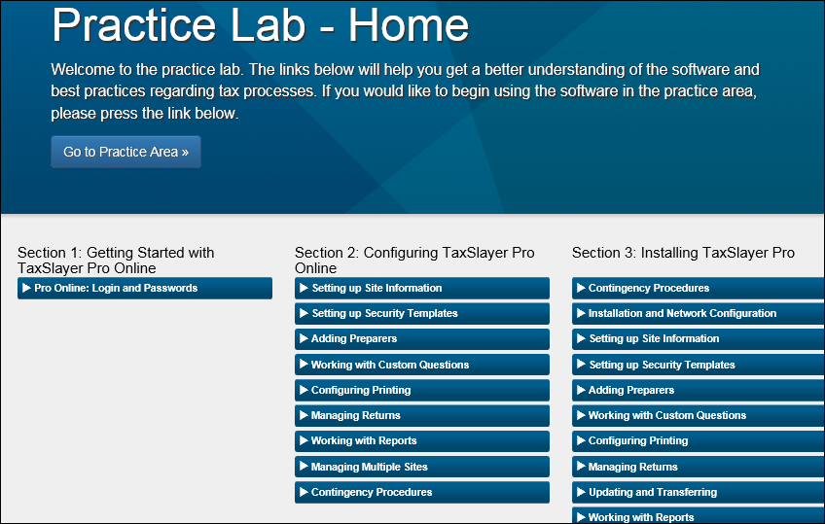
Practice Lab – Home Page
Takes you to practice area
Select a training video
Notes:
Note: Section 1: Getting started with TaxSlayer Pro Online. The Pro Online Login and Passwords video provides you with information about how to long into the production version of TaxSlayer Pro, not the practice lab. To access a video that covers logging into the PL use the url (http://bit.ly/1ZcELb1) found at the bottom of the TaxSlayer Practice Lab Intro document on OSHC. Section 2 contains video that will be used by the LC in setting up the site. Section 3 contains videos for the desktop version of TaxSlayer. We will NOT be using desktop as a contingency.

Slide 12
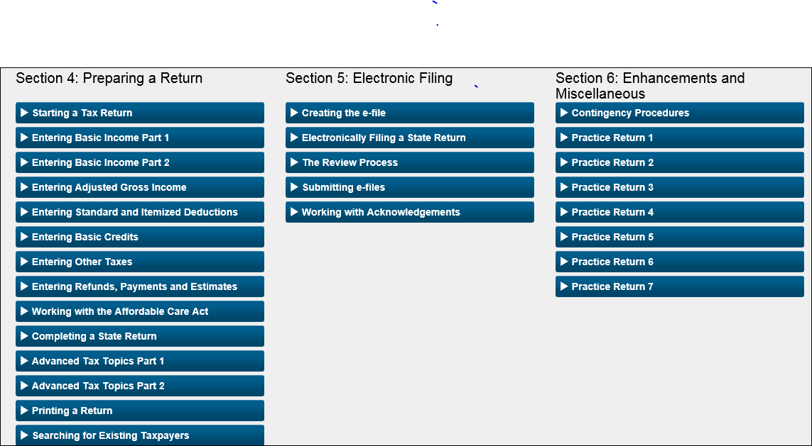
Practice Lab – Home Page (Continued)
Notes:
Section 4 contains videos that cover how to prepare a return and are helpful. Be careful when using the videos as they do contain information that does not match with the current practice lab. For example, the Creating the e-file video found in Section 5 contains information about form 8888 which has not been activated in the practice lab. Section 5 covers e-filing and some can be used for PL. Since you cannot submit an e-file in PL, the last 2 videos in this section do not apply to PL. Section 6 contains practice returns.

Slide 13
Practice Lab Log in Video
OSHC – Tax Training - TaxSlayer
Practice Lab Into – OSHC
Brainshark
Url: http://bit.ly/1ZcELb1
Notes:
REFER TO PRACTICE LAB INTRO DOCUMENT ON OSHC. CONTAINS URL SHOWN ABOVE

Slide 14
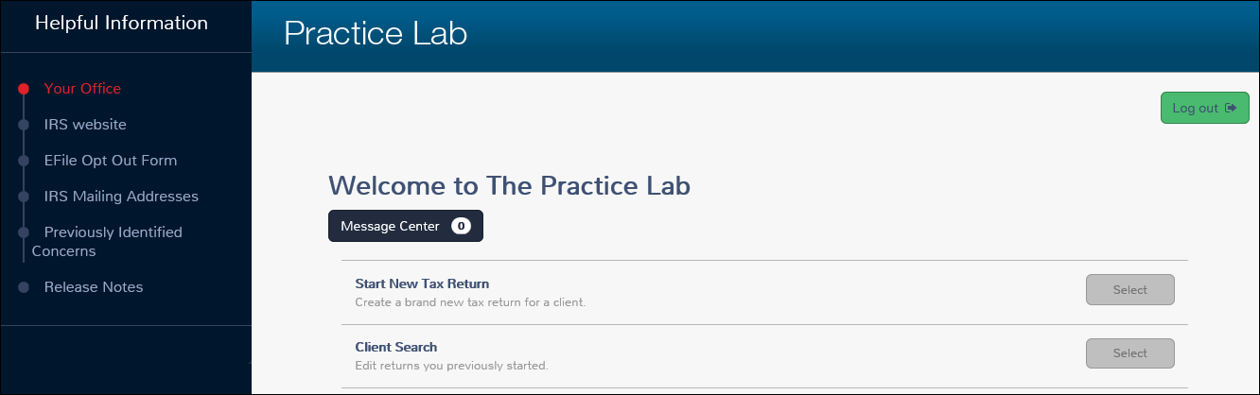
Practice Lab – Welcome Page
Notes:
You will arrive at this welcome page if you select “Go to Practice Area” instead of selecting a video
Ignore “Your Office”. Will not be activated in the practice lab platform
E-file opt out form may be deleted as it does not apply to volunteers
Message Center feature is designed to help the site or local coordinator pass on information to preparers at the site. Also used by TaxSlayer will to provide information regarding changes to the software. It is NOT to be used to submit questions to TaxSlayer.

Slide 15
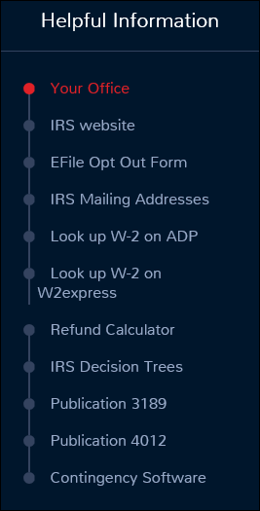
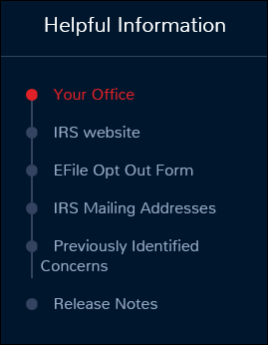
Navigation Bars – PL vs Production
Practice Lab
Production

Slide 16
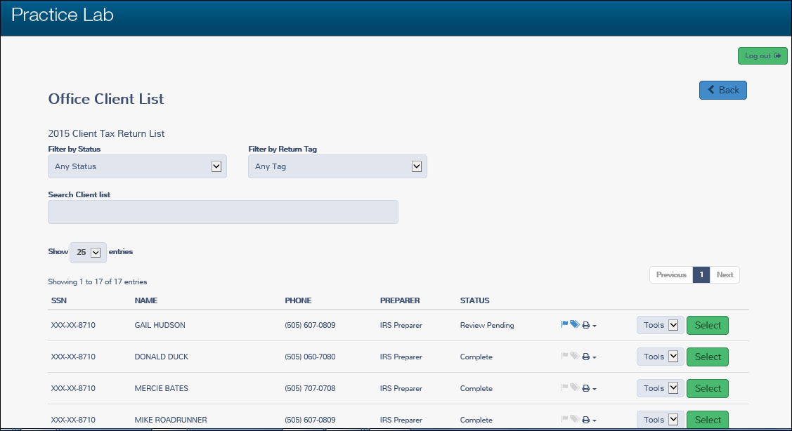
Client Search Screen
Notes:
If you select “Client Search” from the Welcome Page, this screen will appear next.

Slide 17
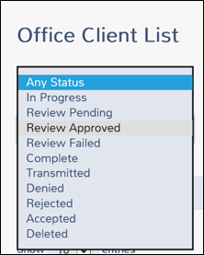
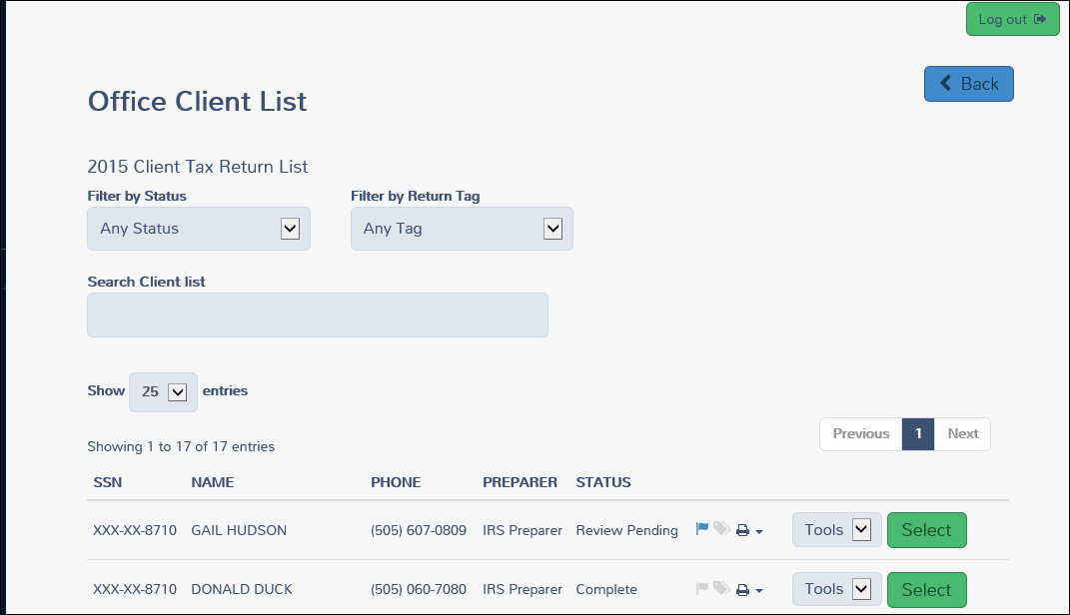
Client Search Screen (Continued)
Notes:
10 choices for client status ranging from in progress to deleted . Status is assigned by the software. The preparer does not assign a status.

Slide 18
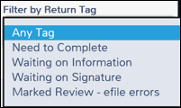
Client Search Screen (Continued)
Notes:
4 choices for return tag. Preparer does assign tags. Can be assigned here or during the input process.

Slide 19
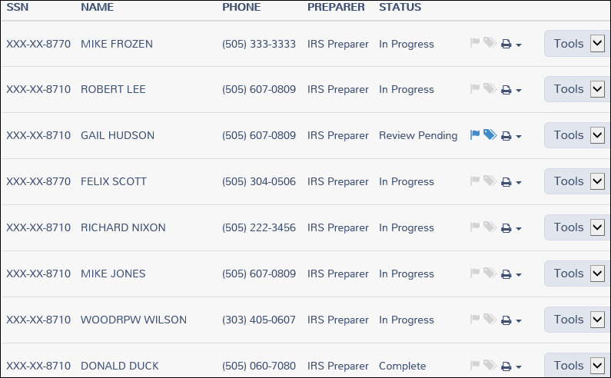
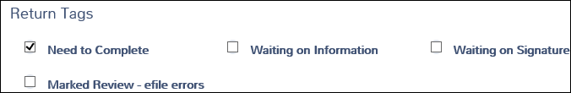
Client Search Screen (Continued)

Slide 20
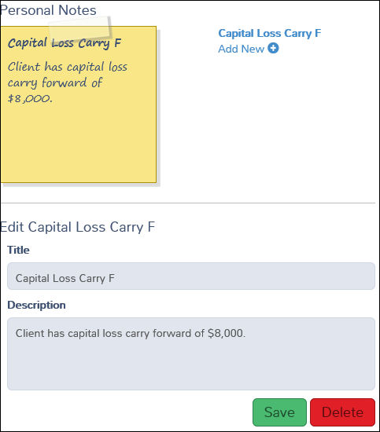
Client Search Screen (Continued)
Notes:
You can add it note here or during input process. If you add a note, when you select e-file, it will give you a warning that you have a note. Does not prevent you from filing the return. It is just a reminder that you added the note.

Slide 21
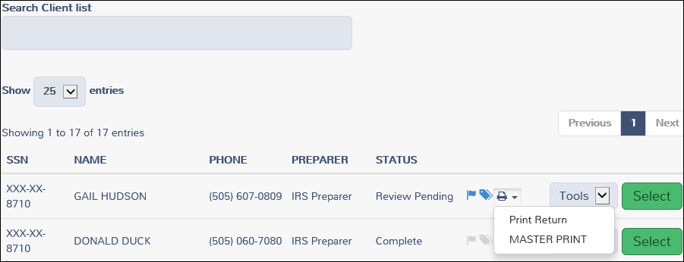
Client Search Screen (Continued)
Prints all forms.
Prints only forms sent to IRS and state.
Notes:
The production platform will most likely contain more than two print choices. Allows you to print return without having to open the return.

Slide 22
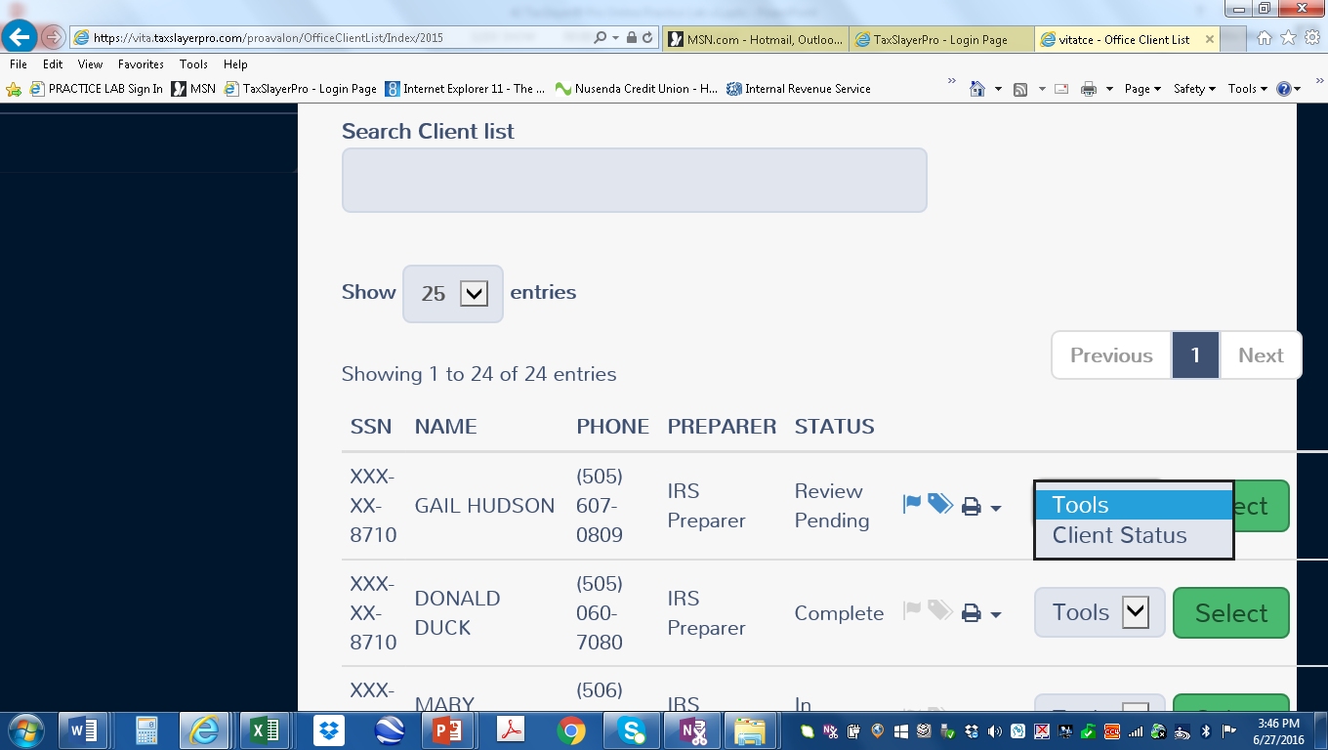
Client Tools
Only tool available in practice lab is Client Status

Slide 23
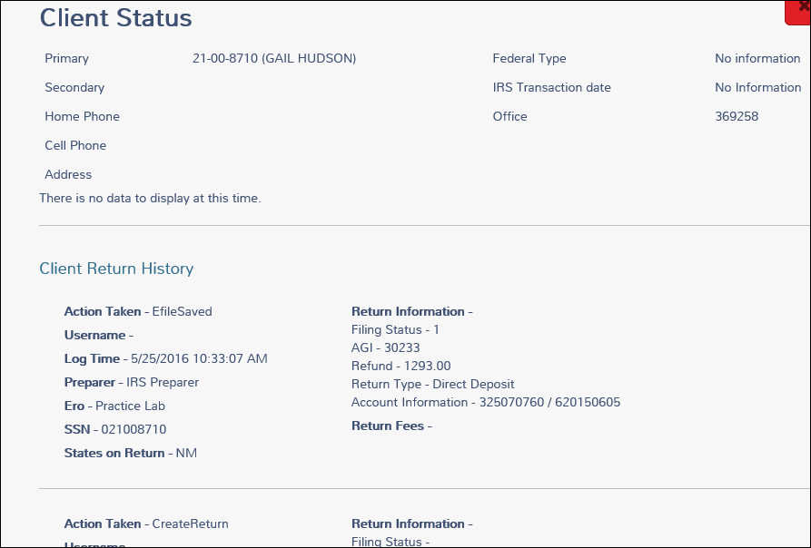
Client Status (Continued)
Notes:
Provides you with a history of what has been done with the return.

Slide 24
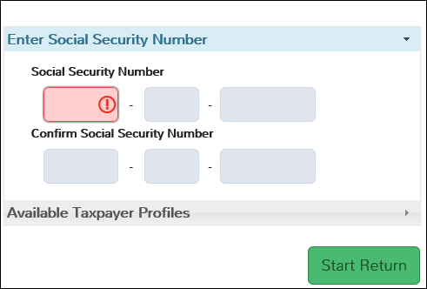
Start New Tax Return Screen

Slide 25
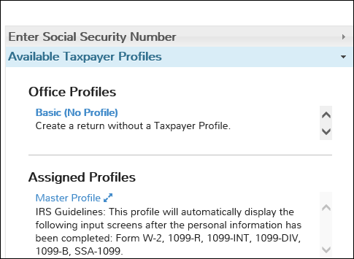
Available Taxpayer Profiles
After completing basic information will take you to income screen.
After completing basic information will take you to W-2 input screen.
Can create additional Taxpayer profiles when setting up site.
Notes:
No limit on number of profiles that can be created.

Slide 26
Navigation/Input Rules
All information is entered via input screen (nothing entered directly on forms)
Use “Tab” key to move from field to field within input screen
Select “Continue” to save information and move from one input screen to another
Notes:
If you enter information and do not click on continue you will get a warning at the top of the page.

Slide 27
Navigation/Input Rules (Cont)
Do not enter leading zeros when entering dates of birth:
Three method of inputting data:
  Guide me
  Enter myself
  1040 View on Calculation Summary page
Notes:
If you are opening an existing return, the software will automatically take you to the 1040 view page. AGE WILL BE SHOWN IN PRODUCTION. EXACT LOCATION TBD.

Slide 28
Navigation
Filing Status is 1st screen you must complete after entering SSN
Filing Status Wizard available
Personal Information screen must then be completed
Dependent screen next (one screen for each dependent)
Notes:
Regardless of which input method you choose you must complete filing status screen first. STOP SLIDE SHOW HERE AND ASK FOR QUESTIONS. AFTER QUESTIONS HAVE EVERYONE OPEN GAIL HUDSON RETURN.

Slide 29
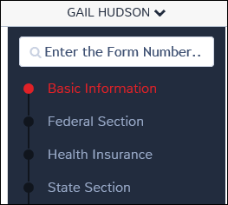
Left navigation bar
Will take you to input screen for form
Section you are in will be red
Input screens for all forms except ACA
ACA input screens
Create state return
Notes:
Once you enter social for new return or select existing return, the screen will contain a new navigation bar.

Slide 30
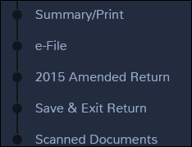
Left navigation bar (Continued)
1040 view, summary and print
Must complete health insurance and EITC to e-file
Amend 2015 return
Takes you to practice lab welcome screen

Slide 31
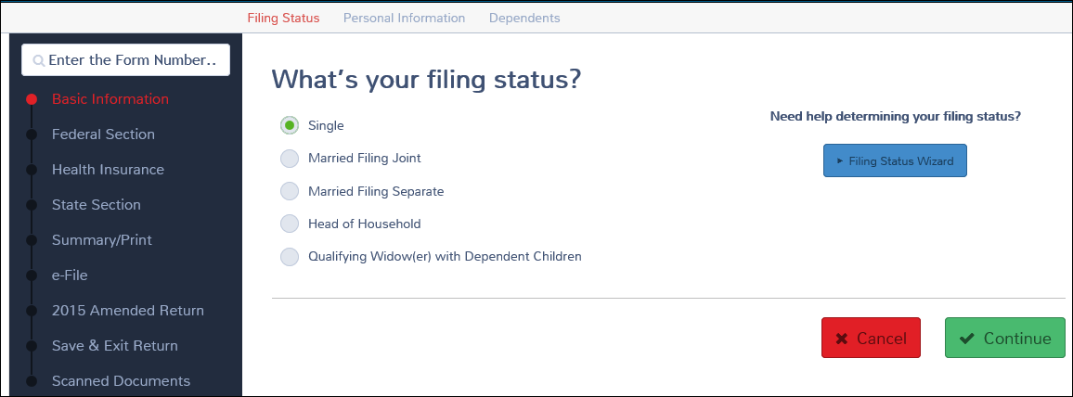
Filing Status Screen
Notes:
Screen you are currently in will be red. Other screens will remain blue.

Slide 32
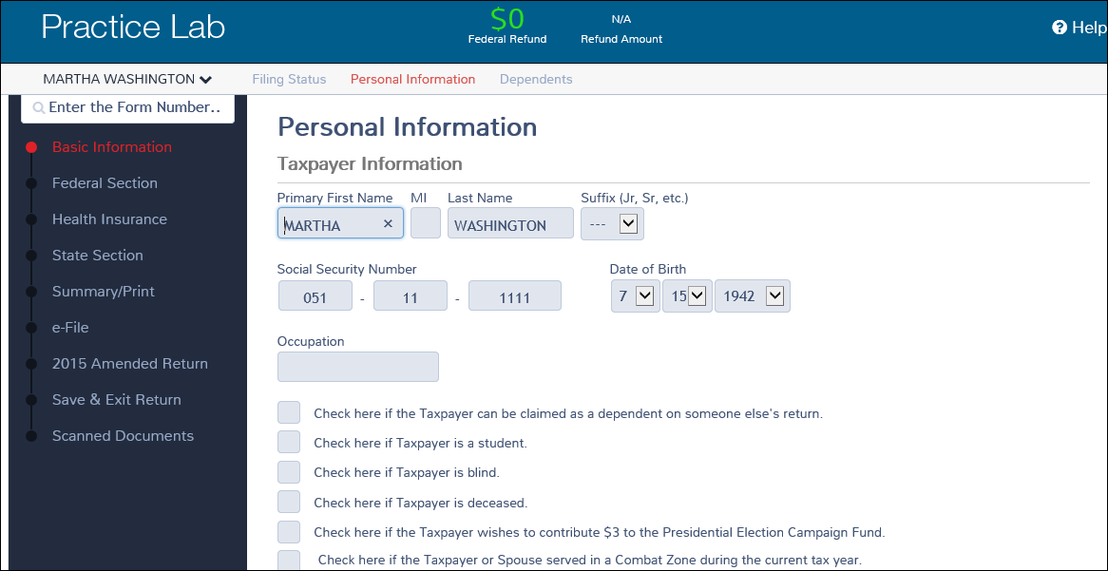
Personal Information Screen

Slide 33
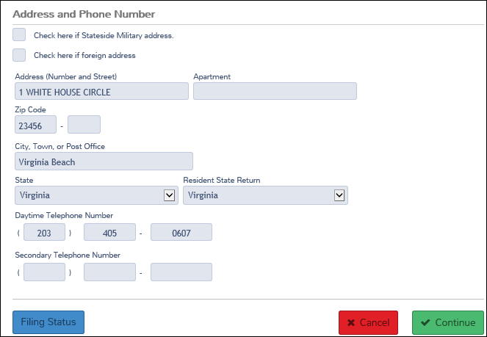
Personal Information Screen (Continued)

Slide 34
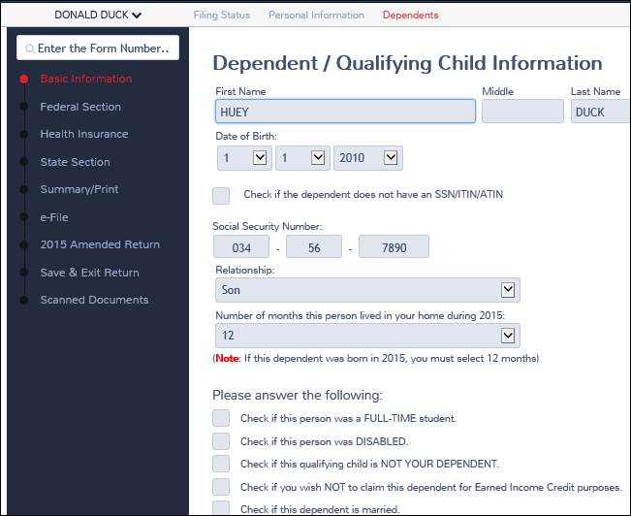
Dependent Information Screen

Slide 35
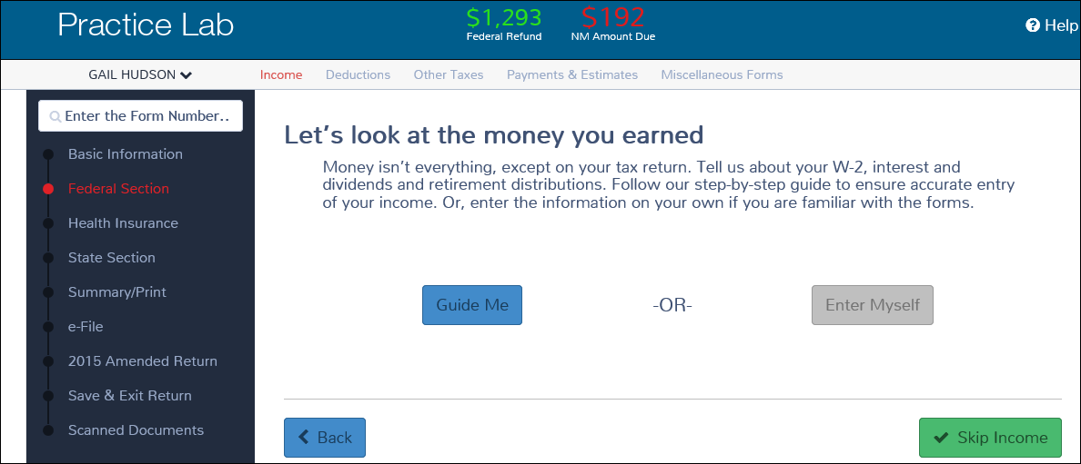
Income Screen
Notes:
If you selected “Assigned Profile” ,or had created a quick file, you would skip this screen and go straight to the W-2 input screen. If you select “Summary Print” from the navigation bar you would skip this screen and go to 1040 view where you could select income and go straight to W-2 input screen.

Slide 36
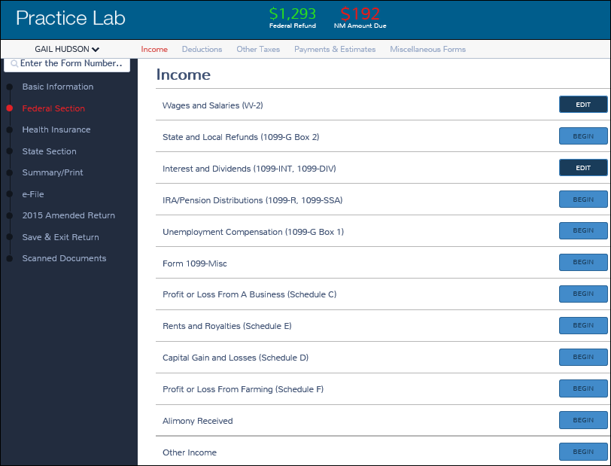
Income Screen
Notes:
Edit (dark blue) to change original input data. Again, if you are using a Taxpayer Profile, have created a quick file list or use the summary print you will skip this screen. NOTE: Every item on this screen except Schedule D and other income can be included in Quick file.

Slide 37
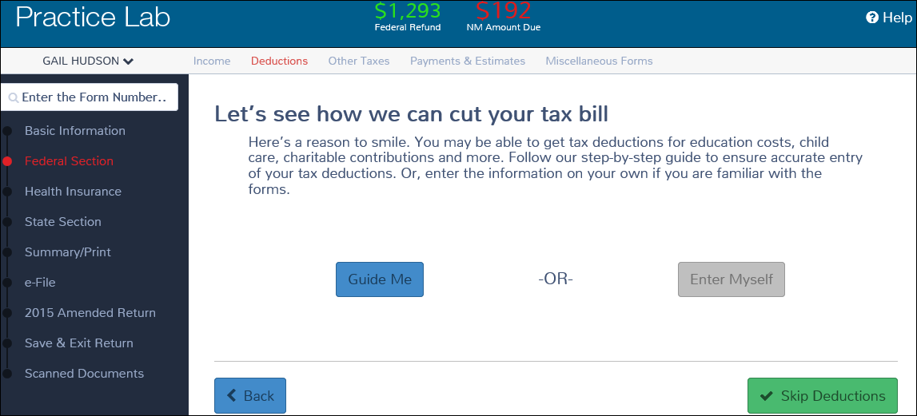
Deduction Screen

Slide 38
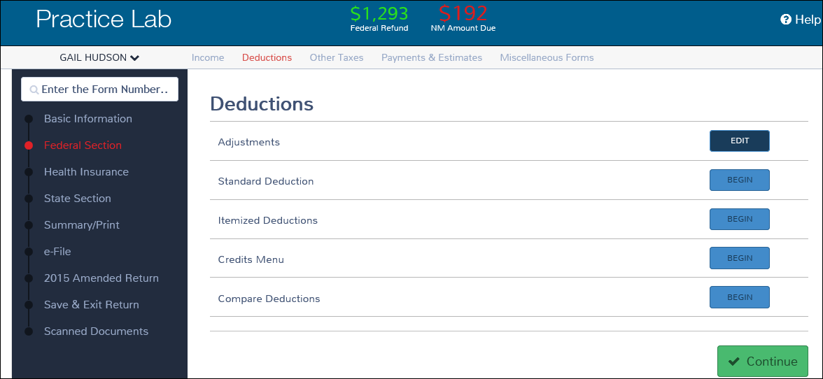
Deduction Screen (Continued)
Notes:
Remember, deductions includes adjustments, itemized deductions and credits. Will not change

Slide 39
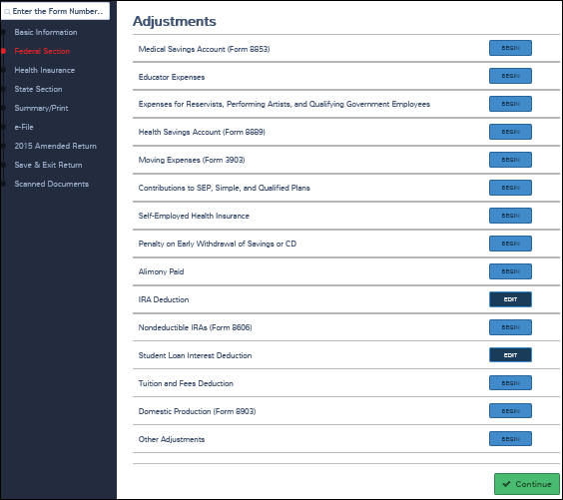
Adjustments Screen
Notes:
Some adjustments can be included when using Quick File (e.g., education expenses, Health Savings Accounts, alimony paid, student loan interest and Tuition and Fees deduction.)

Slide 40
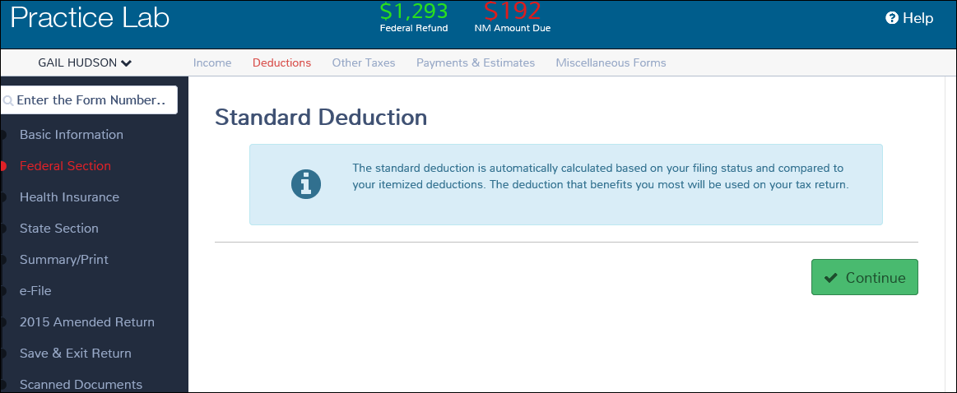
Standard Deduction Screen

Slide 41
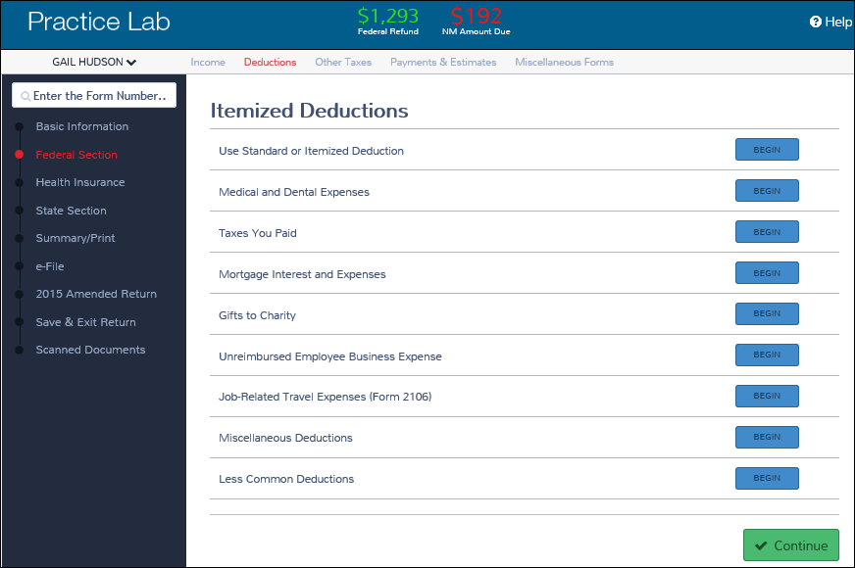
Itemized Deductions Screen
Notes:
Can list some itemized deductions in Quick File (e.g., medical, taxes, mortgage interest, gifts to charity, unreimbursed employee business expenses, and job-related travel expenses) cannot include misc deductions and less common deductions (e.g., business use of home and investment expense).

Slide 42
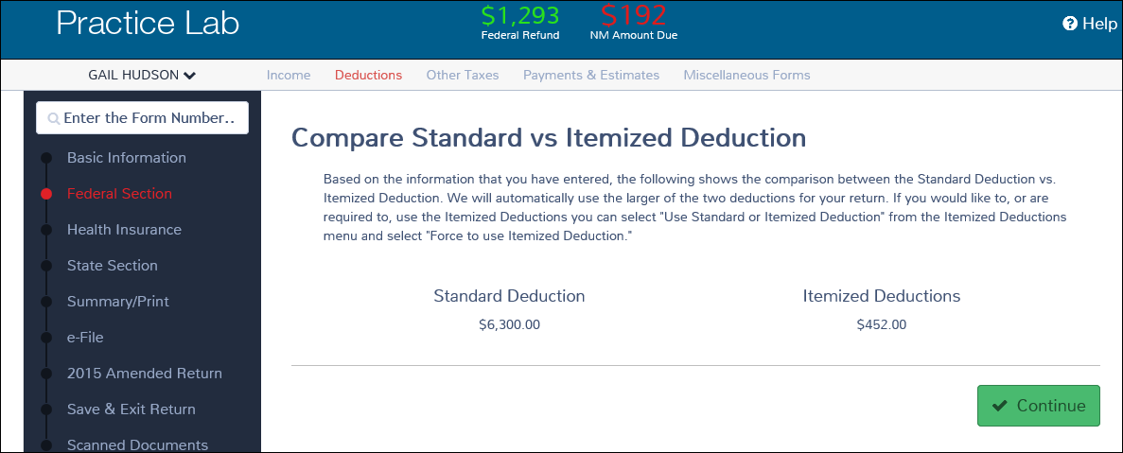
Compare Standard vs Itemized Deduction

Slide 43
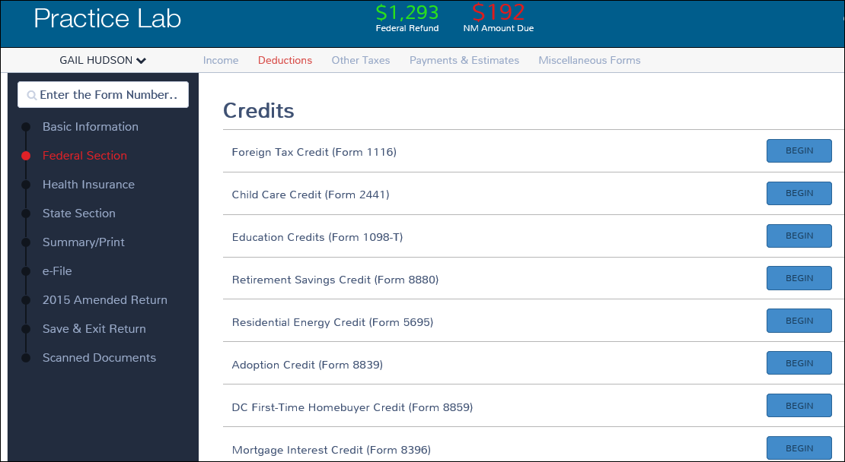
Credits Screen
Notes:
A few credit input screens can be preloaded by using Quick Files. They include: child care credit, education credits (Form 1098-T), residential energy credit (Form 5695), and the credit for the elderly or disabled (Schedule R).
EITC is listed in the Quick File list but to date I have been unable to get it to work. When you get to EITC on the Quick File list you have created, the program will log you out. Issue has been sent to TaxSlayer asking them to fix the problem or remove EITC from Quick File list.

Slide 44
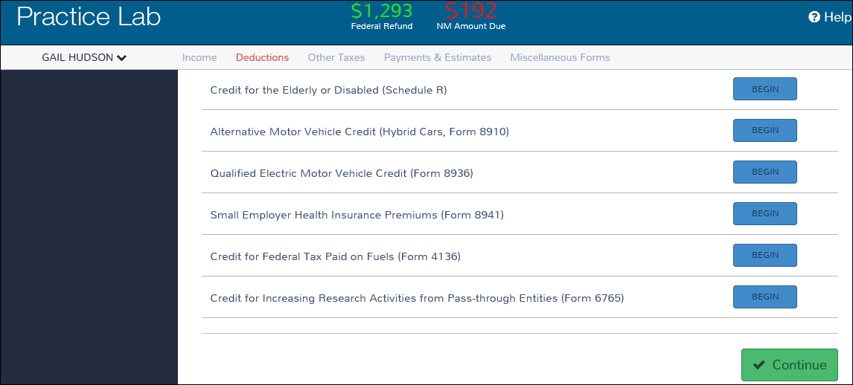
Credits Screen (Continued)

Slide 45
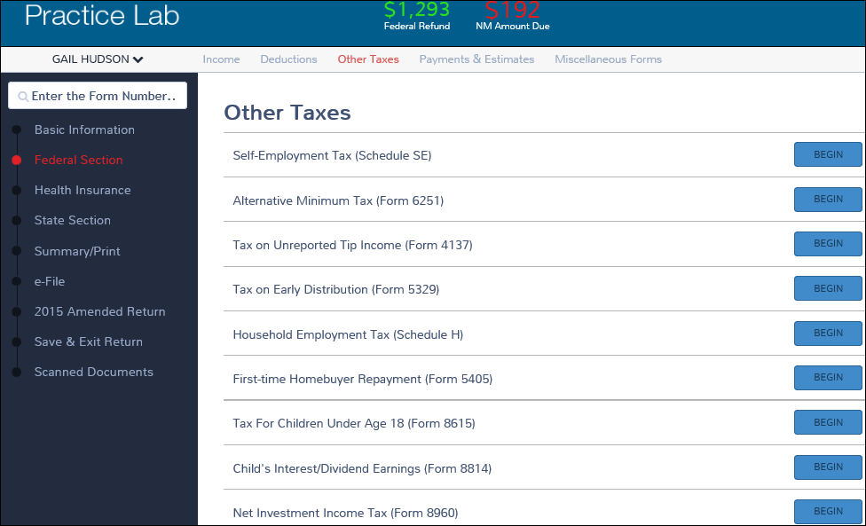
Other Taxes
Notes:
Only item on this list that is included in Quick File is First-time Homebuyer repayment.

Slide 46
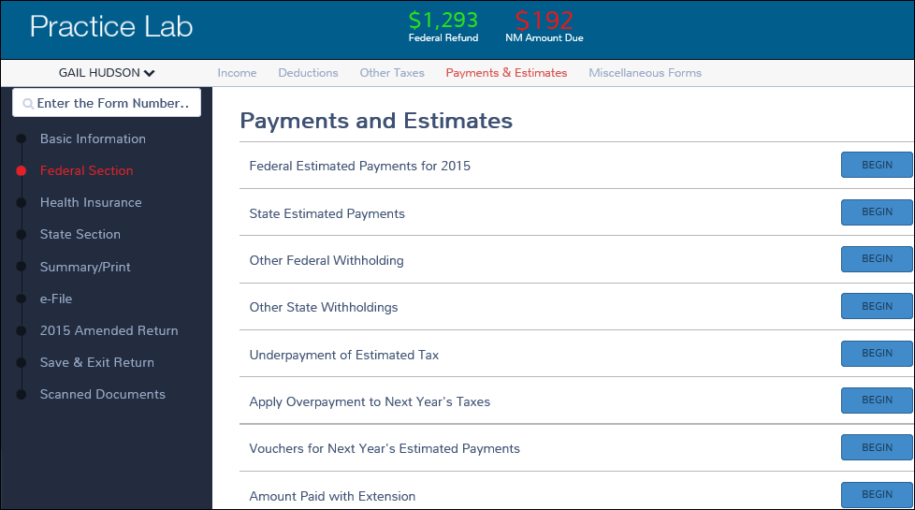
Payments and Estimates
Notes:
Federal and state estimated payments can be preloaded using Quick File.

Slide 47
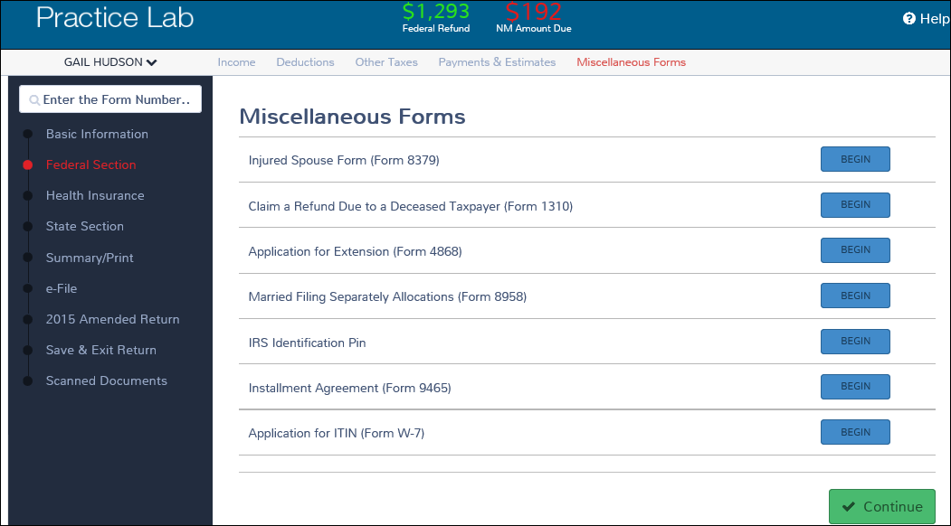
Miscellaneous Forms
Notes:
Quick File items: IRS IP and installment agreement. STOP HERE CLOSE HUDSON AND ASK FOR QUESTIONS – AFTER QUESTIONS, OPEN JAMES SCOTT.

Slide 48
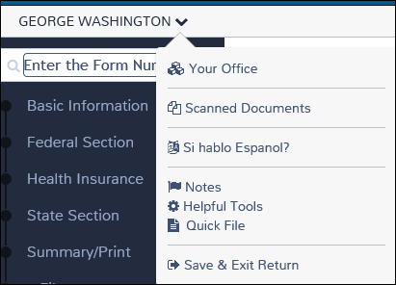
Additional Tools
Select drop down window next to name
Must complete filing status, personal & dependent information to activate tool bar

Slide 49
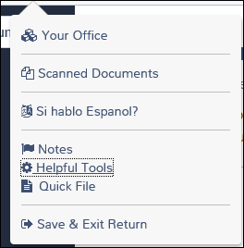
Additional Tools (Continued)
Logs you out to welcome page
Access denied at this time
Select Spanish
Add notes to return

Slide 50
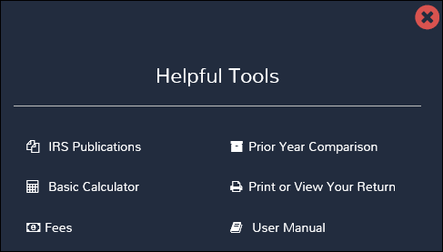
Additional Tools (Continued)
Notes:
Currently user manual is out of date. Will be updated.

Slide 51
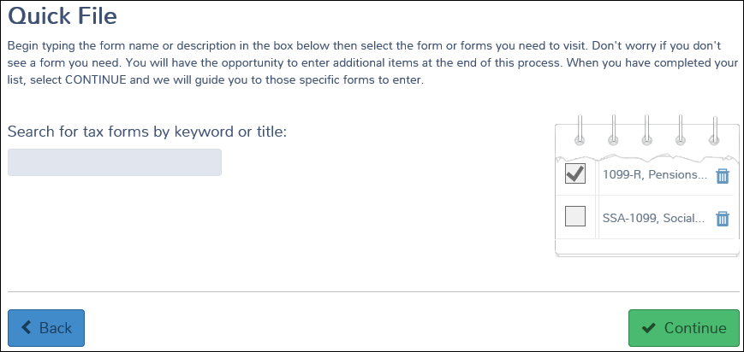
Quick File Tool
Notes:
Stop at this point and demo Quick File using Felix Scott return. Add forms from W-2 to child care credit.

Slide 52
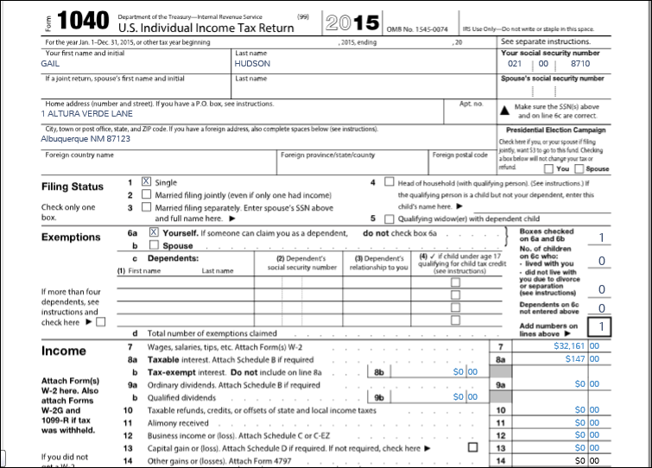
1040 View Screen – page 1
Notes:
Decided to include 1040 view screen at this point. You may want to move it to a different point in presentation. TaxSlayer added the 1040 view feature in response to requests that preparer be able to “see” the return as it was developed and to be able to go directly to the input screen for the line on the 1040.

Slide 53
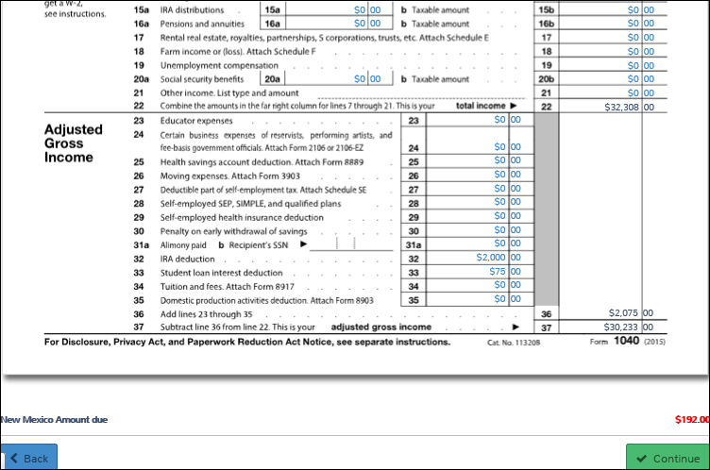
1040 View Screen – page 1 (Continued)
Notes:
You can “see” Navigation Bar on 1040 view screen by reducing size of page (ie-80%)

Slide 54
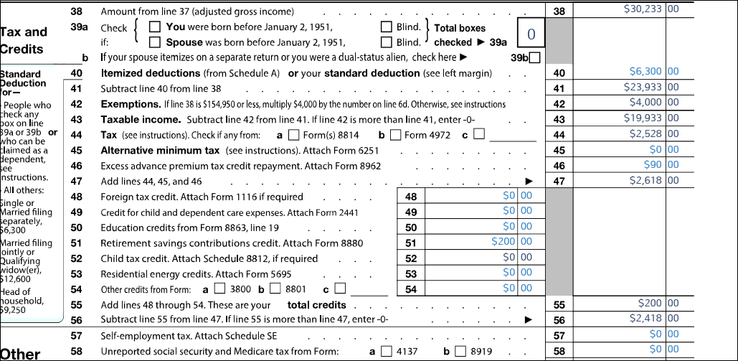
1040 View Screen – page 2

Slide 55
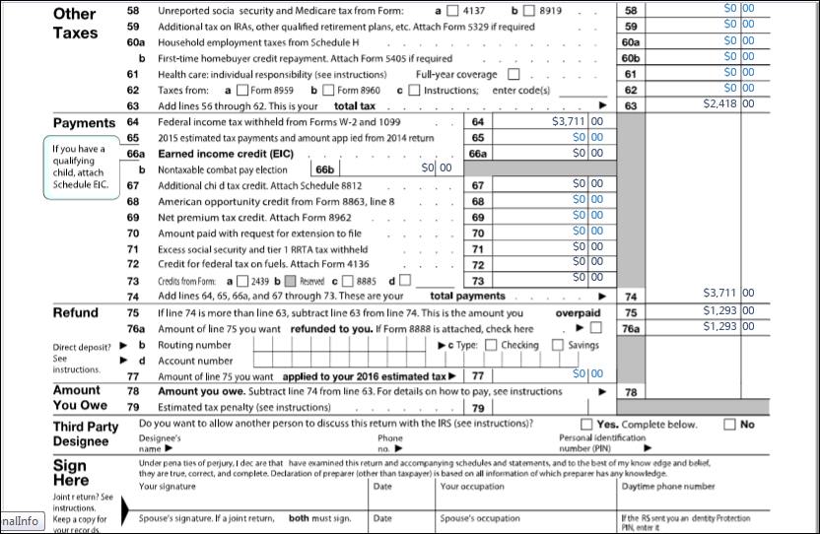
1040 View Screen- page 2 (Continued)

Slide 56
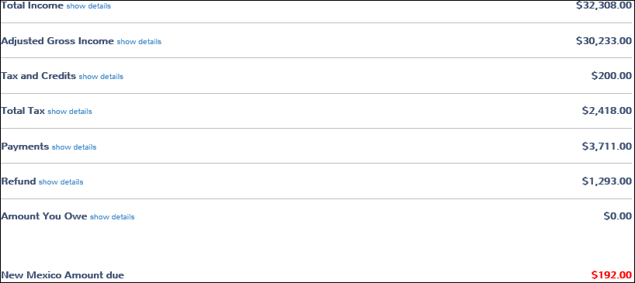
Calculation Summary Screen
Notes:
If you select “summary view” you would land at the calculation summary page where you can drill down to detailed amounts by selecting “show details”.

Slide 57
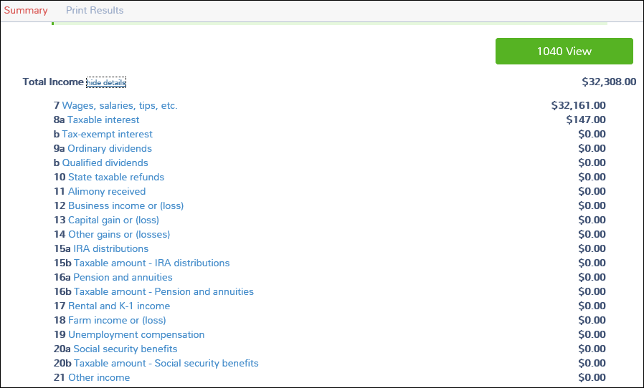
Calculation Summary Detail
Notes:
Detailed view of income summary

Slide 58

E-file Warning
Notes:
If you have added notes you will get a warning here. Does not prevent you from filing return. ASK FOR QUESTIONS AND THEN STAY WITH SCOTT TO DEMO E-FILE PART OF RETURN

Slide 59

E-File
Notes:
Program defaults to direct deposit

Slide 60

E-File Federal Return Type
Notes:
Four choices for federal return type when return includes a refund: electronic mailed (no dd), direct deposit, paper return/dd and paper return no direct deposit

Slide 61

E-File Federal Return Type
Notes:
When Balance Due Four Choices: Mail Payment – Electronic File, Direct Debit – Electronic Filed, Paper Return – Direct Debit, Paper Return – Mail Payment.

Slide 62

E-File (Continued)
Notes:
System creates both taxpayer’s PIN and ERO PIN.

Slide 63

E-File (Continued)

Slide 64

E-File (Continued)
Notes:
For production bank name will be included on screen but will not be a required entry as it is now.

Slide 65

E-File (Continued)

Slide 66

E-File (Continued)
Notes:
If LC makes questions required cannot e-file return unless questions are answered.

Slide 67

E-File Submission

Slide 68

E-File Submission (Continued)

Slide 69
Close a Return
Three ways to close a return:
  After completing e-file, select “Save and Exit Return” button
  Select “Save and Exit Return” from left navigation bar
  Select “Save and Exit Return” from drop down window next to taxpayer’s name
Notes:
All three will take you to Welcome to Practice Lab screen. Will not take you completely out of return.

Slide 70
TaxSlayer/Training
Questions…
Comments…

